Slide 1


People Transformation and
Cloud Operating Model Workshop
Answering the question:
“How can I transform my organization’s skills, structure, and processes to best adopt and derive value from cloud services?”
© 2017

Slide 2
AWS Cloud Stages of Adoption
Notes:
Explain SofA to the customer… ask them where they think they are.

Slide 3
AWS Cloud Stages of Adoption
Notes:
Where are we focusing today? We’re going to give you insight to best practices across the entire journey, but our primary focus is on getting started and then maturing your organization’s roles, responsibilities, and skills throughout the first 3 stages of adoption. True, we have some customers that choose to Reinvent immediately, but as you see on the graph, that is a different path than we typically see for Foundational adoption to migrate and reduce your technical debt. We will dive deep into this concept of “doing both” Innovation and Reducing Technical Debt later in the workshop.

Slide 4

Principals & Agenda of this workshop
Cannot separate a future-state personnel discussion from a future-state Operating Model discussion
Cannot separate a future-state Operating Model discussion from the characteristics of the application in your portfolio
Notes:
What have we learned from working with thousands of enterprises customers over the last 10 years? Not, everyone is the same… not even close; however, there are “patterns of success” and “pitfalls to avoid”. Two principals that have become clear across all customers are:

Slide 5

Principals & Agenda of this workshop
What we will cover is a functional overview of our recommended Cloud Operating Models; including, example cloud team structures and workflows…
...We focus on Operating Model first, because it largely deteremines how your people then fill roles that perform the function that provides capability to your business.
Notes:
Depending on decisions your enterprise has made in the past, there may only be one or two possible paths forward in the immediate future. It’s important to note how you “feel” throughout this workshop… do you find yourself “wishing” for another model, but knowing that it’s not yet within reach? Say something and let’s discuss how we might be able to incrementally move you toward that desired future-state.

Slide 6
Key characteristics of successful cloud transformations
Near constant CHANGE of applications, IT systems, and even business direction is the new normal. Your chosen Cloud Operating Model needs to not only support change, but enable it.
Notes:
These Key Characteristics are not MUST DO; however, these are the principals that our nimble and innovative companies follow to the best of their ability.
1. …

Slide 7
Key characteristics of successful cloud transformations
Near constant CHANGE of applications, IT systems, and even business direction is the new normal. Your chosen Cloud Operating Model needs to not only support change, but enable it.
Business Application owners are ultimately responsible for their applications... but, they will have a lot of help.
Notes:
2. This characteristic is usually where we hear the groans in the room and things like “this sounds like DevOps… we can’t go DevOps… we have too much legacy IT to deal with”. Completely understand and you’re probably right, if you have a ton of legacy IT systems that are in a steady-state mode of operation, you absolutely shouldn’t try to throw those applications into a DevOps model for no good reason. However, I don’t want you to think “this doesn’t apply to me” either, because there is a balance you can strike with this characteristic that will set you up better for future success... We will discuss this in detail (and explain “they will have a lot of help”) later in the workshop.

Slide 8
Key characteristics of successful cloud transformations
Near constant CHANGE of applications, IT systems, and even business direction is the new normal. Your chosen Cloud Operating Model needs to not only support change, but enable it.
Business Application owners are ultimately responsible for their applications... but, they will have a lot of help.
Your Cloud Service should be treated as a “product”, built with agile methodologies, small dedicated teams, and a healthy customer feedback mechanism.
Notes:
3. As the global lead for our Operations practice loves to say… “if your customer thinks that it sucks, it sucks”... You Cloud Service that you offer your customer (most likely your Business Application Owners or Developers) must be offered a large stake in influencing how you’re going to go about adopting cloud at your company. Thinking about your Cloud Service as a Product will help your team(s) build releases with agile methodologies and a healthy customer feedback loop that builds trust throughout your organization.

Slide 9
Cloud Operating Model
Overview
Notes:
Thanks for spending the time to allow us to level set and share some of our best-practices… we’re about dive deeper into the concetps discussed above. Any questions before we move on? ------
Ok, moving on… Before we talk about the transformation of your staff skills, org charts, and functional competencies, we need to start to define your new operating model.

Slide 10
An effective Cloud Operating Model is:
Simple – clearly links how the cloud is run to the expected benefit
Flexible – is able to change over time and in response to customer feedback
User Centric – is built and enhanced by feedback and feature requests by the business users

Slide 11
Why is a Cloud Operating Model important?
An effective Cloud Operating Model is:
Simple – clearly links how the cloud is run to the expected benefit
Flexible – is able to change over time and in response to customer feedback
User Centric – is built and enhanced by feedback and feature requests by the business users
The ultimate value that the business extracts from the Cloud Services offered is determined by the effectiveness of the operating model.
Clearly describes the relationship and expectations between the users of the Cloud Services and the organization(s) that provides the Cloud services.

Slide 12
Cloud Operating Model Overview
Business Services
Cloud Services
Notes:
Talk track: Before we talk about the transformation of your staff skills, org charts, and functional competencies, we need to start to define your new operating model. The Operating Model you choose will ultimately define the staffing, skills, and responsibilities of your future-state organization.
At the very basic level, Business Services (and the Applications that support them) consume Cloud Services. This should drive the IT organization providing Cloud Services to act in a very “customer-centric” model toward the Business Application owners (their customer); however, traditionally, IT organizations have been more stovepipe and authoritarian in their offering to the business.
The adoption of Cloud Services enables IT to “re-write” their story… and for the first time, truly empower to the Business with the right amount of speed, agility, security, and scale to meet their Business goals.
Questions to ask the Customer:
Q. How do we define business services in your case and who is your customer?
Q. Do you have a few first-mover business services / applications identified to move to the cloud first?
Q. Who owns Cloud Services? Does it compete internally or externally (e.g. outsourcing) with other offerings… or do you have a cloud-first policy?
Q. As Cloud Services are matured as offering within your company, how is the communication of what services are available (and roadmap) provided to the Business Services teams?

Slide 13
Components of a Cloud Service
Business Services
Cloud Services
Platform Management
Cloud Service Template
Shared Application Services
IT Service Management
Cloud Business Office
Support Services
Notes:
Platform management – typically some organization that is responsible for looking at the platform as a whole determine how it should be setup and configured – IAM, network routing, how am I going to do monitoring as a whole – shared environment that needs to be managed centrally.
Cloud Service Template – known good state of service – std cloud formation templates provide to application teams to use - Centralized – Proactive Solution – central library… De-centralized – teams manage themselves - Reactive Solution – still need a process to ensure guardrails are in place
Shared Application Services – applications themselves need to consume some common services ie. Backup, AD, DNS, any sort of shared mw/brokerage
IT Service Management – linkage into those governance control mechanisms around – provisioning, incident, release, change – make the hooks into those systems easy to consume
Cloud Business Office – makes the cloud services team function as a business. evangelizes the could service. talks to user base to understand the needed features, and build out the roadmap. on-boarding the users to tools, pipeline, education etc
Support Services – support to the end users – 1st line help desk, FAQ, Knowledge base

Slide 14
Components of a Cloud Service
Business Services
How is the Cloud Service delivered?
Cloud Services
Platform Management
Cloud Service Template
Shared Application Services
IT Service Management
Cloud Business Office
Support Services

Slide 15
Cloud Services Functional Overview
Business Services
Cloud Business Office (CBO)
Enterprise Architecture, Training, On-boarding, Finance/Budgets
Governance, Compliance, Standards, Evangelism
Cloud Engineering
Cloud Services
Infrastructure
Operations
Security
Architecture
Dev / Engineering
Operations
Architecture
Dev / Engineering
Operations
Architecture
Dev / Engineering
Operations
Notes:
CBO presents what Cloud Engineering creates.
Activities of a CBO:
Acts as a concierge to the business users.
Analysis of enterprise application portfolios
Business case / value analysis / TCO studies
Migration planning and sequencing
Architectural consulting for application teams
Managing relationships with cloud providers
Managing relationships with training partners
Reporting/charging back to customers
Communications and internal event planning to promote cloud adoption and community building

Slide 16
Business Applications View
Business Services
Portfolio
Portfolio
Portfolio
Application
Application
Application
Cloud Service
Platform Management
Cloud Service Template
Shared Application Services
IT Service Management
Cloud Business Office
Support Services
Notes:
Now that we’ve dug into what makes up a well-operated Cloud Service, let’s zoom back out and take a look at maybe the most important piece to your cloud operating model…

Slide 17
Business Applications View
Business Services
Portfolio
Portfolio
Portfolio
Application
Application
Application
What does your portfolio look like?
Cloud Service
Platform Management
Cloud Service Template
Shared Application Services
IT Service Management
Cloud Business Office
Support Services
Notes:
...the characteristics of your current portfolio of applications.
Add color and details specific to your customer’s situation… Centrally managed? Distributed? Shadow IT? Outsourced? If yes, Infrastructure only or Apps too?

Slide 18
Typical Enterprise Portfolio Characteristics
Portfolio Tier | Requirements | Typical Use Cases | Operating model | Approx. % Portfolio*
Differentiate | High rate of change & innovation; Possibly business-critical, but not always | Customer-facing web, IoT, Big Data, Real-time Analytics, Mobile | DevOps | ~20%
Table Stakes | Business critical, but low rate of change. Needs highest availability, maximum reliability. | Business-critical systems of record, ERP, CRM, Legacy line-of-business apps | Steady-state (high automation) | ~30%
Craplications | Low rate of change, minimal risk, standard downtime & reliability requirements | Productivity app, Non-Business-critical, Small Customer-base | Steady-state (low automation) | ~50%
 | *by number of applications, not percent of spend
Notes:
Next we’re going to show you some options for operating, but your application’s characteristics and business demands for agility will drive which options you select.

Slide 19
Typical Enterprise Portfolio Characteristics
Reason:
Portfolio Tier | Requirements | Typical Use Cases | Operating model | Approx. % Portfolio*
Differentiate | High rate of change & innovation; Possibly business-critical, but not always | Customer-facing web, IoT, Big Data, Real-time Analytics, Mobile | DevOps | ~20%
Table Stakes | Business critical, but low rate of change. Needs highest availability, maximum reliability. | Business-critical systems of record, ERP, CRM, Legacy line-of-business apps | Steady-state (high automation) | ~30%
Craplications | Low rate of change, minimal risk, standard downtime & reliability requirements | Productivity app, Non-Business-critical, Small Customer-base | Steady-state (low automation) | ~50%
 | *by number of applications, not percent of spend
Innovate
Reduce Tech Debt
Notes:
If you look at the reasson why you’re looking to leverage cloud for these applications, it’s really two different reasons… while cost-savings is always in-styl, the Differentiate tier is going to cloud for innovation and agility reasons. While, Table Stakes and Craplications are moving usually for cost-savings or durability reasons.
Next we’re going to show you some options for operating, but your application’s characteristics and business demands for agility will drive which options you select.

Slide 20
Cost-savings and Innovation ROI
Investments into innovative applications increase top line revenue
Continually increasing margins
Migration of existing applications results in cost-savings
Notes:
Remember when we said our most successful customers are going down both paths? Here’s why. The combination of both approaches (cost-savings and innovation) are key to driving top line revenue up and IT cost down… increasing total operating margin and making your company stronger and not just cheaper.

Slide 21
Cloud Services Functional Full View
Applications
Applications
Applications
Business Services
Architecture
Dev / Engineering
Operations
Architecture
Dev / Engineering
Operations
Architecture
Dev / Engineering
Operations
Cloud Business Office (CBO)
Enterprise Architecture, Training, On-boarding, Finance/Budgets
Governance, Compliance, Standards, Evangelism
Cloud Services
Cloud Engineering
Infrastructure
Operations
Security
Architecture
Dev / Engineering
Operations
Architecture
Dev / Engineering
Operations
Architecture
Dev / Engineering
Operations
Notes:
Full view summary. Questions on what makes up your cloud service or comments on the make up of your portfolio?

Slide 22
Operating Model Scenarios
Based on the characteristics of applications in your portfolio, you will most likely select two or more models for operating applications most efficiently
Notes:
How does your current operating model work now?

Slide 23
Cloud Operating Model
Design
Operate
Deploy & Operate Code
Business Applications
Design Code
CHANGE
ITSM
EVENT / TICKET
CATALOG
Cloud Service
Service Presentation
Deploy & Operate Service
ORCHESTRATION
Notes:
No matter the breakout responsibilities between different groups, organizations, or outsourcers… within every enterprise, a basic flow occurs:
Key Call Out – Value is determined during Design. Value is delivered during operate.
Application teams determine a change required for their application. Typically this some kind of change to application code and related configuration
When the code and configuration is ready, the application team select a cloud service for the change to be deployed to. In the case of a production environment this should be a service that has required service outcomes such as reliability, security ’baked’ into a pre-approved template. In a full DevOps environment, the team may create all required templates themselves, however this places a very high bar on both the development team and operations / governance functions.
Once a service is selected, a call is made via an orchestration tool to the Cloud Service to instantiate the Cloud Service. This orchestration tool can range from the AWS Console, to a toolchain such as Jenkins through to a Cloud Management Platform.
The Service is instantiated, and the configurations included within the Service Template applied. Whoever operates the service will usually want to ensure they have all required integration completed as part of the orchestration workflow
Once the Service is ready a bidirectional workflow starts between the Cloud Service provider and the Application support or operations team
When a change is required to the running stack, ideally the cycle starts again, with a new stack launched with the required change. However, this function may call a service to change the running stack rather than launch a new stack. Either way the cycle repeats.
Q. At what point should compliance occur?
Q. Where do we test service outcomes, and who does this?

Slide 24
Typical Enterprise Portfolio Characteristics
Portfolio Tier | Requirements | Typical Use Cases | Operating model | Approx. % Portfolio*
Differentiate | High rate of change & innovation; Possibly business-critical, but not always | Customer-facing web, IoT, Big Data, Real-time Analytics, Mobile | DevOps | ~20%
Table Stakes | Business critical, but low rate of change. Needs highest availability, maximum reliability. | Business-critical systems of record, ERP, CRM, Legacy line-of-business apps | Steady-state (high automation) | ~30%
Craplications | Low rate of change, minimal risk, standard downtime & reliability requirements | Productivity app, Non-Business-critical, Small Customer-base | Steady-state (low automation) | ~50%
 | *by number of applications, not percent of spend
Innovate
Reduce Tech Debt
Notes:
Next we’re going to show you some options for operating, but remember your application’s characteristics and business demands for agility will drive which options you select.

Slide 25
Operating Model Scenarios
Steady-State Applications A
Steady-State Applications B
Design
Ops
Design
Ops
Apps
Dev Team / COTS**
Managed* Hosting
Dev Team / COTS
Managed App Ops
-Or-
Infra
Cloud Engineering
Cloud Engineering
Managed Infra Ops
*Managed is defined as a fully-monitored and supported app/infra stack. Could be outsourced or internal.
**Commercial-off-the-shelf (COTS) software

Slide 26
Placeholder for one workflow diagram

Slide 27
Operating Model Scenarios
DevOps A
DevOps B
Design
Ops
Design
Ops
Apps
Dev Ops
DevOps
-Or-
Infra
Cloud Engineering

Slide 28
Responsible Party per Delivery Model (samples)
Design
Ops
Design
Ops
Design
Ops
Apps
COTS
Vendor
Accenture
Apps
Business
Business
Apps
xxxx
yyyy
Steady-State
DevOps
Etc.
Infra
IBM
IBM
Infra
IBM
Business
Infra
zzzz
nnnn
SAMPLE PARTNERS
Notes:
High level RACI defines responsible party and who will participate across time. SAMPLE

Slide 29
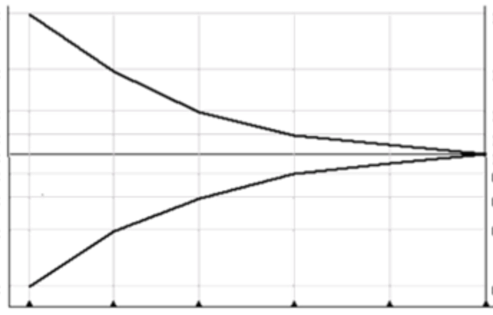
Team Sizing and Efficiency Correlation
Legacy architectures forklifted onto AWS requires similar roles/workforce as on-premise. Lack of automation means Cloud Eng can only manage a “few” apps each.
“Forklift, then Refactor” to enables automation to be introduced, enabling Cloud Eng to assist the business with operating “tens” of applications at once
Optimal for new app dev; “build it / run it” strategy breeds accountability. Cloud Eng can assist business with operating “fleets” of applications at once
Steady-State
(low automation)
Number of
Roles, Teams,
& Responsibilities
Steady–State (high automation)
DevOps
Full automation
Codified processes/
Automation efficiencies
Roles required
to operate
Cloud Engineer L2
Cloud Engineer L1
Current Shared Services
Cloud Engineer L3
Cloud Engineer L2
Cloud Engineer L3

Slide 30
Organizing a Cloud Team
Customer Org Chart example based on your chosen Operating Model
Notes:
First we’re going to start with the end in mind…

Slide 31
Build with the end in mind…
The Cloud Transformation Organization is a window into the future of the entire organization; creating the foundation for an agile, iterative, and customer-centric operating model to be adopted at scale as applications and their developers become cloud-native.
Chief Information Officer
Cloud Transformation
(SVP / VP)
Cloud Engineering & Enablement
(Director)
Cloud Business Office
(Director)
Infrastructure
Engineering
Operations
Engineering
Security
Engineering
Migration
Discovery & Planning
Architecture & Governance
On-Boarding
Program Management Office
Training & OCM
Cost, Value, & Provider Management
Communication, Community, & Advocacy
Notes:
This deck is focussed on providing customers with an introduction to and the steps needed to ensure they are ready for migration to the cloud. It covers a wide range of topics and brings together in one presentation the key concepts needed to kick-start a migration project. We believe that your organization will one day look like this… but let’s not start here, let’s start small and build repeatable successes first...

Slide 32
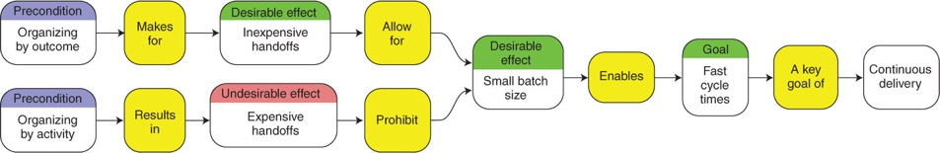
Staffing a Cloud Transformation
Product vs. Project – Aligning for Outcomes vs. Activities
High-performing, modern IT organizations align around outcomes and autonomy. Why is this?
Outcomes are independently valuable and achievable
A greater degree of autonomy can be given to a team that is responsible for an outcome
Owning an outcome also gives a team a sense of purpose
By contrast, when organized by activity, no single team owns an outcome.
Activity-level optimization is a common cause of silos and the lengthening of end-to-end cycle times due to hand-offs between activity centers
Expensive handoffs between teams prohibit the organization from working in small batches, and therefore, continuous delivery
Outcome (product) oriented teams incentive ownership and quality via accountability

Slide 33
Staffing a Cloud Transformation
Product vs. Project – Aligning for Outcomes vs. Activities
The key pivot when transforming from traditional IT to a “Cloud-Native Operating Model” is to adopt a customer-obsessed, product-oriented delivery model across the organization.
This means organizing around outcomes, not activities.
This includes not only your application teams, but Infrastructure, Operations, and Security as well.

Slide 34
But, where do you start?

Slide 35
Step One: Launching a Cloud Tiger Team
The first step in your cloud transformation is to create a small, empowered, and accountable product team – a “Tiger Team” – that owns the outcome of establishing cloud strategy and standards, and migrating the first few applications
Cross-Functional Tiger Team
A cross-functional product team, representing each of the functional domain that will be embodied in the long-term Cloud Transformation team:
Should be hands-on and capable of addressing the full lifecycle, from architecture to implementation
Establishes guiding principles and long-term roadmap for cloud adoption
Establishes foundational configurations and standards for technologies and services consumed or deployed
Partners with a few, select early-adopters to ensure the voice of the customer is represented even in early iterations and MVPs
Delivers MVP cloud service offerings across all CCOE functions and concerns, and take a few, select early-adopting customers into production
Performs the following operational roles for MVP cloud offerings and application customers:
Applications
Infrastructure
Cloud Business Office
Security
Operations
Architecture
Engineering
Operations
Support

Slide 36










Step One: Staffing a Cloud Tiger Team
The Tiger Team should be empowered, cross-functional, and product-oriented; accountable for delivering their committed outcome end-to-end, and ensuring those outcomes continuously meet and exceed customer expectations
Cross-Functional Tiger Team
 | Product Manager: Works directly with business and/or development customers to generate and prioritize backlog of services or features to be delivered. |  | Lead Architect: Accountable for overall cloud technical architecture; partners with Product Manager to translate customer requirements into technical deliverables; establishes technical direction; does technical delivery as well.
 | Infrastructure Engineers: Provide integrations with corporate datacenters, shared cloud infrastructure services, and engineering and continuous improvement of stacks, templates, images, and other artifacts. |  | Security Engineers: Provide standardized offerings to facilitate ongoing security and compliance within application stacks and the cloud environment overall; Integrates security standards and controls into other cloud team products and offerings.
 | Operations Engineers: Provide offerings to facilitate the successful deployment of stacks: CI/CD, artifact repositories, upgrades & patching; Provide offerings to facilitate ensure operational health of stacks: metrics, logging, alerting, inventory, capacity, and billing/tag management. |  | Application Engineers: Work closely with the all members of the Tiger Team to provide the voice of the customer as cloud services are being developed; Early adopter of cloud services and practices who provides continuous feedback to the rest of the product team(s).
7-10 People
= 2 Pizza
Team

Slide 37
Step Two: Building for Cloud Transformation
The Cloud Transformation Organization is a window into the future of the entire organization; creating the foundation for an agile, iterative, and customer-centric operating model to be adopted at scale as applications and their developers become cloud-native.
A Cloud Transformation Organization will contain the following teams:
Chief Information Officer
Cloud Business Office serves as a central point of governance across architecture, finance, vendors, and migration projects – while driving the broader transformation through advocacy and community-building, training and certification, and organizational change management
Cloud Infrastructure teams provide common shared infrastructure for all cloud platform consumers, and work across Application Teams, Cloud Engineering Teams, and the Cloud Business Office to offer their required infrastructures as consistent and codified “stacks”.
Cloud Operations teams are accountable for providing reusable services, tools, processes, and deployment artifacts for Application Teams and Cloud Engineering Teams to successfully manage the operational lifecycle of their stacks.
Cloud Security teams are accountable for providing reusable services, tools, processes, and deployment artifacts for Application Teams and Cloud Engineering Teams to successfully ensure the security and compliance of their stacks.
Cloud Migration teams are dedicated to identifying applications to be migrated to public cloud, as well as planning and executing their migrations.
Cloud Transformation
(SVP / VP)
Cloud Engineering & Enablement
(Director)
Cloud Business Office
(Director)
Infrastructure
Engineering
Operations
Engineering
Security
Engineering
Migration
Discovery & Planning
Architecture & Governance
On-Boarding
Program Management Office
Training & OCM
Cost, Value, & Provider Management
Communication, Community, & Advocacy
Notes:
This deck is focussed on providing customers with an introduction to and the steps needed to ensure they are ready for migration to the cloud. It covers a wide range of topics and brings together in one presentation the key concepts needed to kick-start a migration project.

Slide 38
Step Two: Building for Cloud Transformation
As your adoption of cloud scales, so will the Tiger Team – an ideal Cloud Transformation organization will be made of empowered and dedicated resources, organized under a single leader, and co-located in a single, physical workspace that promotes transparency and collaboration
A dedicated, co-located model enables:
Cohesiveness of the end-product and its constituent components and solutions
Well-defined ownership and accountability over the entire set of desired outcomes
Efficiency of technical delivery and communication
Minimized costs and delays associated with context switching across multiple projects
Aligned goals and incentives that breakdown in a matrixed model across teams and leaders
Chief Information Officer
Cloud Transformation
(SVP / VP)
Cloud Engineering & Enablement
(Director)
Cloud Business Office
(Director)
Infrastructure
Engineering
Operations
Engineering
Security
Engineering
Migration
Discovery & Planning
Architecture & Governance
On-Boarding
Program Management Office
Training & OCM
Cost, Value, & Provider Management
Communication, Community, & Advocacy
Notes:
This deck is focussed on providing customers with an introduction to and the steps needed to ensure they are ready for migration to the cloud. It covers a wide range of topics and brings together in one presentation the key concepts needed to kick-start a migration project.

Slide 39
Step Three: Scaling the Cloud Transformation
As you cloud services offerings expand and mature, you may find that your Cloud Engineering teams are not able to simultaneously keep up with their backlog of new features and enhancements, while also enabling new application teams to adopt the cloud platform and operating model.
Adding complimentary resources for operations and support enables:
Level 2 support for centrally provided cloud service offerings
Level 2 support for steady-state applications that want to realize the operational benefits (cost, availability, security) of the cloud, but can’t justify a full DevOps operating model.
Ability to scale pairing and coaching to team application teams to self-service and consume cloud service offerings
Rotation between Engineering and Ops teams to ensure cross-training and feeding voice-of-the-customer feedback into product backlogs.
Chief Information Officer
Cloud Transformation
(SVP / VP)
Cloud Engineering & Enablement
(Director)
Cloud Business Office
(Director)
Infrastructure
Engineering
Operations
Engineering
Security
Engineering
Migration
Discovery & Planning
Architecture & Governance
On-Boarding
Program Management Office
Infrastructure
Ops & Support
Operations
Ops & Support
Security
Ops & Support
Migration Execution & Transition
Training & OCM
Cost, Value, & Provider Management
Communication, Community, & Advocacy
Notes:
This deck is focussed on providing customers with an introduction to and the steps needed to ensure they are ready for migration to the cloud. It covers a wide range of topics and brings together in one presentation the key concepts needed to kick-start a migration project.

Slide 40
Step Three: Scaling the Cloud Transformation
Each functional component of the Cloud Transformation org may also need to be scaled, and become composed of multiple, two-pizza product teams, each with their own product manager, lead architect, and engineers
Operations Engineering
Chief Information Officer
Continuous Delivery
Metrics, Logging, and Reporting
Cloud Transformation
(SVP / VP)
Inventory, Capacity, and Billing
Cloud Engineering & Enablement
(Director)
Cloud Business Office
(Director)
Infrastructure Engineering
Shared Infrastructure (VPN, DX, VPC, DNS)
Infrastructure
Engineering
Operations
Engineering
Security
Engineering
Migration
Discovery & Planning
Architecture & Governance
On-Boarding
Program Management Office
Compute, Network, & Storage
Infrastructure
Ops & Support
Operations
Ops & Support
Security
Ops & Support
Migration Execution & Transition
Training & OCM
Cost, Value, & Provider Management
Communication, Community, & Advocacy
Runtime, Middleware, & Data
Notes:
This deck is focussed on providing customers with an introduction to and the steps needed to ensure they are ready for migration to the cloud. It covers a wide range of topics and brings together in one presentation the key concepts needed to kick-start a migration project.

Slide 41
Next Steps
Cloud Operations Assessment
Skills Assessment
Cloud Roles Training
MRP
DevOps Accelerator

Slide 42
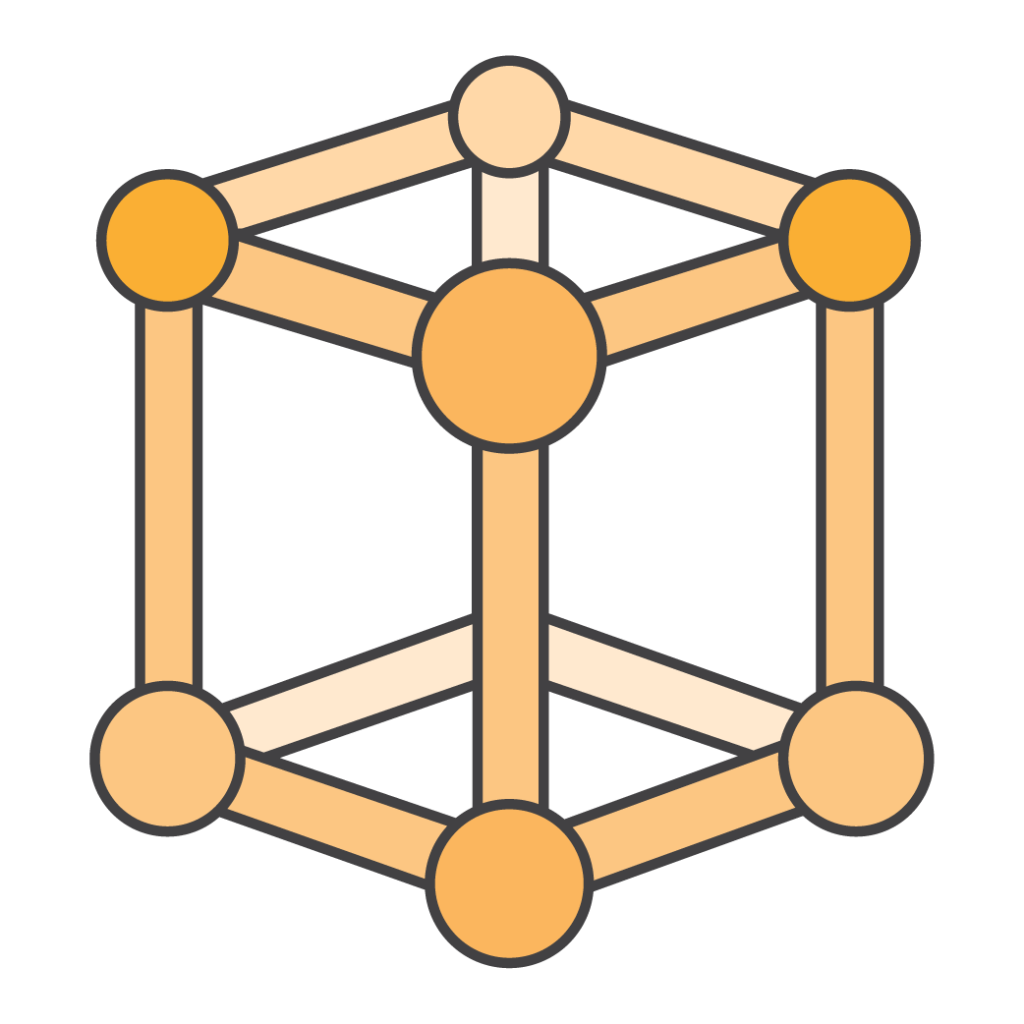
ProServe Operations Integration
ProServe Cloud Operations
Assessment
Part of the OI Engagement Workflow
© 2017

Slide 43
Introduction
Cadence of engagements performed by AWS ProServe as part of the Cloud Operations Assessment:
ProServe consultants act as part of a joint customer / partner project team to deliver the first cycle (agile delivery construct) user stories. In particular this cycle;
Once complete, the goal of Cycle 1 is to deliver Minimum Viable Product (MVP) capabilities for supporting required operational service outcomes for production workloads
User stories for Cycle 1 are usually limited to 12 weeks in delivery duration
Establishes the feedback mechanism for planning and delivering future cycles
Customers obtain information about effective management and operation of cloud environment such as the Cloud Adoption Framework, the Well-Architected Framework and the AWS Managed Service Provider program.
Inform
Assessment
Cycle 1
Cycle n
ProServe OI is engaged to help plan the initial set of operational capabilities needed to support business objectives. The assessment process;
Ensures the business and service objectives are articulated
Determines the operational capabilities needed to meet business and service outcomes defined
Determines the level of business change implied, and the readiness to execute
Devises a mix of AWS ProServe solutions to deliver the required capabilities
Defines Cycle 1 wants/needs in the form of user stories (e.g. agile project framework) and prioritizes efforts
Future cycles planned and executed by the the customer and/or AWS partner to enhance the operational outcomes beyond the MVP capabilities. AWS ProServe usually moves to more of a thought-leader / assurance role in Cycle n.

Slide 44
Assessment Engagement Flow
Day | Activity
1
2
3
4
5
6
7
8
9
10
Typical Assessment is run over 10 working days (non-consecutive days is okay)
This can be longer depending the scope of the cloud platform (e.g. multiple locations, multiple cloud platforms, etc.)
Each workshop is typically 2-3 hours
Assessment is performed by 1-2 AWS OI resources depending on the maturity of existing planning
Sponsor Kickoff
Existing Documentation & Working Setup
Workshop 1 : Cycle 1 Infrastructure Stories
Workshop 2 : Cycle 1 Application Stories
Workshop 3 : Cycle 1 Service Outcomes
Workshop 4 : Cycle 1 Delivery Methodology
Workshop 5 : Sponsor MoSCoW Grooming
Workshop 6 : Cloud Operating Model
Workshop 7 : Operational Domains
Workshop 8 : Operational Roles
Workshop 9 : Migration Health
Workshop 10 : AWS Solution Health
Workshop 11 : Operational Tooling
Workshop 12 : Ability to Execute Change
Cycle 1 Product Backlog
Cycle 1 High-Level Design
Complete Discovery Dashboard
Sponsor Presentation

Slide 45
Sample of Cycle 1 - Infrastructure Stories (Epics)
No. | As an | I can
1 | Application Developer | Order a compliant, fully managed (architecture) stack of AWS infrastructure
2 | Application Developer | Select a compliant, fully managed operating system for use on AWS
3 | Application Developer | Configure my application to have access to and from the Internet
4 | Application Developer | Configure my application to be accessible to and from internal network spaces
5 | Application Support | Request my application stack and related data be restored as needed
6 | Application Support | View all events & logs related to my application
7 | Application Owner | Select a defined service level (RPO/RTO/Uptime) for my application
8 | Application Support | Detect an issue occurring within my AWS application stack and be able to engage other teams to support resolution
9 | Application Developer | View the performance metrics for my application stack to determine required changes
10 | Application Support | Ensure no changes are made to the application stack without permission

Slide 46

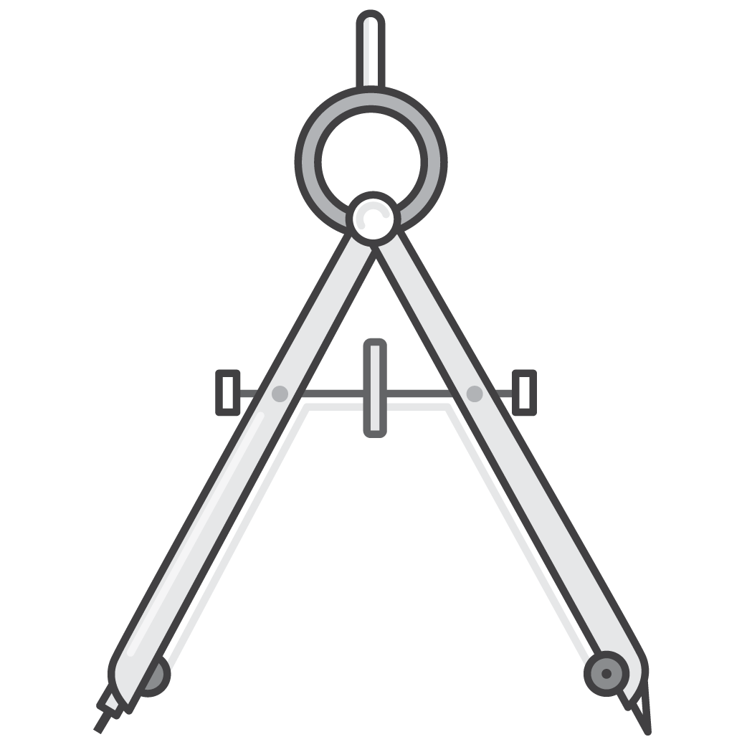

Assessment Output
At the conclusion of the Assessment engagement, ProServe provides the customer with;
Cycle 1 “Product” Backlog
A prioritised list of user stories for the initial release, with the operational requirements for those stories included
Cycle 1 High-level Design
A brief solution design based upon AWS OI standard package offerings, partner offerings and any existing capabilities being reused
Cycle 1 Delivery Proposal
A document outlining the delivery team, project roles and responsibilities, potential ProServe SOW and approach to Cycle n delivery

Slide 47
Assessment details
Session | Description | Customer Attendees | Key Data Points
Sponsor Kick-off | Initial meeting with the project sponsor to discuss short, medium and long-term outcomes and specific considerations for the discovery | Customer Sponsor AWS Account Manager OI Delivery Lead | SOW Existing AWS usage information & operational health indicators
Existing Documentation & Working Setup | Review of existing cloud project documentation (if available) and setup of onsite working area, communication mechanisms etc. | Customer Project Lead | Existing cloud strategy and usage documentation Cloud architecture and configuration documentation
Cycle 1 Infrastructure Stories | Interactive workshop to review and develop Cloud Infrastructure user stories | Customer infrastructure representatives – Server, Storage, Network, OS IT operations and governance owners | Required Cloud infrastructure capabilities Required Cloud Management interfaces
Cycle 1 Application Stories | Interactive workshop to review and develop Cloud Application user stories | Owners of applications slated to migrate to Cloud Application release managers Testing managers | Required Application Management tooling Required Cloud consumption interfaces

Slide 48
Assessment details
Session | Description | Customer Attendees | Key Data Points
Cycle 1 Service Outcomes | Interactive workshop to document the ITSM, Security, Financial and Governance service outcomes which must be delivered by applications operating in AWS | Representative from customer ITSM, SDM, Security, Business Continuity and Financial management teams | Existing IT governance policies, standards and guidelines
Cycle 1 Delivery Methodology | Discussion and review with customer / partner project management and delivery team to agree potential team structure and delivery approach for the Cycle 1 Backlog | Customer project manager, Scrum master and project team | Project charter and delivery documentation Resource planning Issues and Risks register
Product MoSCoW prioritisation | Meeting with the project sponsor to review the output of the backlog workshops, and agree the relative prioritisation | Project Sponsor | Cycle 1 Product Backlog
Cloud Operating Model | Workshop to review and agree the planned operating model for the Cloud. The operating model covers the relationship between users, applications, operations and support within the Cloud. | Customer enterprise architects, application owners and operations teams. | Cloud enterprise architecture

Slide 49
Assessment details
Session | Description | Customer Attendees | Key Data Points
Operational Domains | Workshop to step through and examine the 15 operational domains required for Cloud operations | IT Service Management, Security Management and Operations resources | Cloud Architectures, Operational architectures
Operational Roles | Workshop to agree the roles and responsibilities (RACIs) for the operational management and support of the cloud platform | IT Service Management, Security Management and Operations resources | Current and planned operational RACIs
Migration Health | Workshop to review existing and planned migrations to AWS. Covers operational management and support of workloads during transition. | Migration Teams, Cloud Team, Applications which have or are planning to migrate to AWS | Migration project planning and project documentation
AWS Solution Health | Workshop to review the health of the AWS solution in relation to best-practices such as Well-Architected | Cloud Architects, Application Architects with knowledge of the current AWS configuration | Current and planned AWS architecture

Slide 50
Assessment details
Session | Description | Customer Attendees | Key Data Points
Operational Tooling | Workshop to review the architecture, use and planning for operational management tooling such as provisining, ITSM, CMDB, financial management etc | Cloud Architects, ITSM tools owners | Current and planned operational tooling documentation
Ability to execute business change | Workshop to determine ability of customer to implement the business change required if the product backlog is implemented | Business Change office Experienced project delivery resources within customer | Customer business change strategy
Sponsor Presentation | Presentation of the Discovery output to the project sponsor | Project sponsor AWS Account Manager Project Lead / Manager | Discovery Dashboard Cycle 1 Product Backlog Cycle 1 High-Level Design Cycle 1 Delivery Proposal

Slide 51
Staffing for Outcomes
Product vs. Project – Aligning for Outcomes vs. Activities
High-performing, modern IT organizations align around outcomes and autonomy. Why is this?
Outcomes are independently valuable and achievable
A greater degree of autonomy can be given to a team that is responsible for an outcome
Owning an outcome also gives a team a sense of purpose
By contrast, when organized by activity, no single team owns an outcome.
Activity-level optimization is a common cause of silos and the lengthening of end-to-end cycle times due to hand-offs between activity centers
Expensive handoffs between teams prohibit the organization from working in small batches, and therefore, continuous delivery
Outcome (product) oriented teams incentive ownership and quality via accountability

Slide 52
Staffing a Cloud Tiger Team
It’s important to staff the Tiger Team with individuals who embody, represent, and drive the change you want to see realized as your cloud transformation scales across the organization.
Customer-Obsessed: Committed to designing and delivering products (outcomes) that reflect customer needs, not personal wants or opinions
Biased for Action: Willing to be decisive and hands-on in any aspect of product creation, across its lifecycle; from seeking out customer feedback, to writing code, to deployment, and even being on-call.
Iterative: Delivers small, continuous improvements to products; delivering and demonstrating value more frequently, avoiding long-term missteps; balances customer priorities with cleaning up technical debt.
Accountable: Demonstrates a strong sense of ownership and purpose; being empowered and autonomous demands high levels of accountability to continuously drive product maturity forward while ensuring integration with other products and applications
Learning: Deliberately seeks out new ideas and experiences, feedback from customers and peers, while communicating and sharing information proactively.
Trusting: Helps create a culture of trust between customers, teams, and teammates to ensure that information is shared freely, not hidden; creates shared incentives and wins to ensure the best possible outcomes for bother the customer and the team.

Slide 53
Functional Roles – Common Across All Functions
The following functional roles will be common across all Cloud Engineering teams, and can be co-located within a single team, or across multiple teams, depending on the organization’s operating model
Architecture | Designs standardized and reusable services that enable its development and/or business customers to achieve the organization’s requirements for speed, resiliency, performance, and security; while providing an exceptional automated and self-service customer-experience.
Engineering / Development | Engineers, implements, and continuously improves the quality of standardized and reusable services being offered by the cloud services team to its development and/or business customers. Provides approved templates, images, and other reusable artifacts to enable consumption of standardized and reusable services by customers.
Operations | Partners directly with development and/or business customers to coach them through the successful adoption of the cloud services team’s standardized and reusable services and associated artifacts. Ensures all services and enablement artifacts are available, secure, and continuously improved throughout their lifecycle; addressing any service issues that impact development and/or business customers Provides traditional managed operations and support for applications not operating in a full-stack / DevOps operating model
Notes:
This deck is focussed on providing customers with an introduction to and the steps needed to ensure they are ready for migration to the cloud. It covers a wide range of topics and brings together in one presentation the key concepts needed to kick-start a migration project.

Slide 54
Functional Domain – Cloud Business Office
The Cloud Business Office serves as a central point of governance across architecture, finance, vendors, and migration projects – while driving the broader transformation through advocacy and community-building, training and certification, and organizational change management
Responsibilities | Enterprise architecture and governance for cloud-native applications & operations Financial oversight and management of cloud operating budgets and/or chargeback to customers On-boarding of development teams and architectural alignment of their applications Selection, on-boarding, and management of cloud service providers Product management for cloud services and artifacts | Training and certification for cloud providers, services, and artifacts Publication and management of enterprise knowledge for providers, services, and artifacts Management of enterprise stakeholders Communications across the enterprise Evangelism and community-building across the enterprise
Activities | Analysis of enterprise application portfolios Business case / value analysis / TCO studies Migration planning and sequencing Architectural consulting for application teams Managing relationships with cloud providers | Managing relationships with training partners Reporting/charging back to customers Communications and internal event planning to promote cloud adoption and community building
Skills | Cloud-native architecture across applications, infrastructure, operations, and security Agile product-oriented management practices Coaching, training, and development Financial management | Procurement and contract negotiation Vendor management Organizational change management Enterprise communications and event planning
Notes:
This deck is focussed on providing customers with an introduction to and the steps needed to ensure they are ready for migration to the cloud. It covers a wide range of topics and brings together in one presentation the key concepts needed to kick-start a migration project.

Slide 55
Functional Domain – Infrastructure
Infrastructure teams provide common shared infrastructure for all cloud platform consumers, and work across Application Teams, Cloud Engineering Teams, and the Cloud Business Office to offer their required infrastructures as consistent and codified “stacks”.
Responsibilities | Integration with corporate datacenters and/or 3rd party infrastructure: VPN, DirectConnect, firewalls, etc… Management of shared cloud infrastructure services: AWS Organizations and Accounts VPC, IPAM, Security Groups, NACLS, & Routing Active Directory, Federation, DNS, and others Consultation on all aspects of AWS cloud infrastructure offerings. | Engineering and continuous improvement of stacks, templates, images, and other artifacts to standardize consumption of shared cloud services and delivery of application-specific infrastructure: Instance types, machine images, container images, networks, and storage offerings Application runtimes, integration middleware, relational databases, NoSQL, and BI environments
Activities | Engineering, management, and support of cloud infrastructure products and stacks Partnering with existing enterprise IT organization to integrate cloud infrastructure/network environment with corporate infrastructure / data center environment Hands-on technical coaching to accelerate cloud infrastructure learnings across the organization | Pair with engineering teams to design and implement codified stacks that meet the needs of their applications Operate and support cloud team products and legacy applications not operating in a full-stack operating model. Drive infrastructure as code and configuration management communities of practices across the organization.
Skills | Experience with infrastructure-as-a-service platforms: AWS, Google Compute Engine, Azure, Soft Layer, OpenStack, etc… Experience with configuration management and automation tools such as: Chef, Puppet, and Ansible Experience with orchestration template technologies such as: OpenStack Heat, AWS Cloud Formation, Azure Resource Manager, Google Cloud Deployment Manager, and Hashicorp Terraform | Experience with containers and container scheduling and management platforms such as: Docker, rkt, Mesos, or Kubernetes Experience managing traditional enterprise platforms for compute, network, and storage Experience managing traditional enterprise platforms for application runtimes, integration middleware, and relational databases, Experience with programming and scripting languages: Ruby, Go, Python, Perl, bash, ksh Experience with development using Github or Bitbucket
Notes:
This deck is focussed on providing customers with an introduction to and the steps needed to ensure they are ready for migration to the cloud. It covers a wide range of topics and brings together in one presentation the key concepts needed to kick-start a migration project.

Slide 56
Functional Domain – Operations
Operations teams are accountable for providing reusable services, tools, processes, and deployment artifacts for Application Teams and Cloud Engineering Teams to successfully manage the operational lifecycle of their stacks.
Responsibilities | Providing standardized offerings to facilitate the successful deployment of stacks: Continuous build, test, integration, and deployment platforms and pipelines Repositories & registries for build/deployment artifacts Automated testing frameworks for applications and infrastructure Automated processes for upgrades & patching (blue/green) | Providing standardized offerings to facilitate ensure operational health of stacks throughout their lifecycle: Metrics collection, aggregation, and visualization Log collection, aggregation, and correlation Event management and routing Inventory, capacity, and billing/tag management Clean up and decommissioning of unused or uncompliant resources
Activities | Engineer, manage, and support cloud operations products Collection of metrics and generation of relevant reporting mechanisms to assess and communicate health/success of cloud platform and its application customers Hands-on technical coaching to accelerate cloud operations learnings across the organization | Pair with application teams to design and implement continuous testing and delivery practices practices within their applications Pair with application teams to design and implement practices that ensure their operational health & excellence Operate and support cloud team products and legacy applications not operating in a full-stack operating model. Drive continuous delivery and full-stack operations communities of practices across the organization.
Skills | Experience with continuous integration and deployment technologies Experience with test-driven development frameworks for application and infrastructure code Experience with configuration management and automation tools such as: Chef, Puppet, and Ansible Experience with infrastructure-as-a-service platforms Experience with orchestration template technologies | Understanding of automation practices throughout the development, build, and deployment phases of the application life-cycle Experience with tooling to support monitoring, telemetry, logging, and reporting/dashboarding, and continuous delivery technologies Experience with programming and scripting languages: Ruby, Go, Python, Perl, bash, ksh Experience with development using Github or Bitbucket
Notes:
This deck is focussed on providing customers with an introduction to and the steps needed to ensure they are ready for migration to the cloud. It covers a wide range of topics and brings together in one presentation the key concepts needed to kick-start a migration project.

Slide 57
Functional Domain – Security
Security teams are accountable for providing reusable services, tools, processes, and deployment artifacts for Application Teams and Cloud Engineering Teams to successfully ensure the security and compliance of their stacks.
Responsibilities | Providing standardized offerings to facilitate the successful secure access to stacks and the cloud environment overall Identity and Access Management Identity Federation / SSO SEIM and Audit Logging (CloudTrail & Config) Threat and Vulnerability Detection & Remediation Management of Security Groups and ACLs Perimeter security with WAF and Shield DDoS Data-in-Transit / Certificate Management Data-at-Rest / Key/Secret Management Cloud provider control-plane (console) audit and compliance | Integration of security standards and controls into other cloud team products and offerings: Continuous build, test, integration, and deployment platforms and pipelines Repositories & registries for build/deployment artifacts Automated testing frameworks for applications and infrastructure Automated processes for upgrades & patching (blue/green) Metrics collection, aggregation, and visualization Log collection, aggregation, and correlation Event management and routing Inventory, capacity, and billing/tag management
Activities | Engineer, manage, and support cloud security products Hands-on technical coaching to accelerate cloud security learning across the organization Pair with application teams to design and implement secure coding and continuous security practices within their applications | Perform regular testing and scanning of cloud products and application customers to ensure compliance with overall security standards Operate and support cloud team products and legacy applications not operating in a full-stack operating model. Creation of continuous security communities of practices across the organization.
Skills | Experience with continuous security practices, including: threat modeling, threat and vulnerability management, secure coding practices, and automated penetration testing. Experience with network / perimeter security platforms Experience with encryption in-flight and at-rest practices, as well as certificate and secrets management Experience with security event & incident management (SEIM) | Experience with infrastructure automation, infrastructure as code, automated application deployment, monitoring/telemetry, logging, reporting/dashboarding, and continuous delivery technologies Experience with orchestration template technologies Experience with programming and scripting languages: Ruby, Go, Python, Perl, bash, ksh Experience with development using Github or Bitbucket
Notes:
This deck is focussed on providing customers with an introduction to and the steps needed to ensure they are ready for migration to the cloud. It covers a wide range of topics and brings together in one presentation the key concepts needed to kick-start a migration project.

